Slide 1
074
 | Bulk | Heavy | Medium | Light
Weight (g) | 240 | 235 | 3.15 | 1.75
Vol (mL) | 305 | 295 | 5.5 | 4.0
Bulk Density (g/mL) | 0.788 | 0.797 | 0.573 | 0.438
Proportion (%) | 100 | 98.0 | 1.31 | 0.73
AF (ppb) |  | 1.97, 1.45 | 20.5 | 20.4

Slide 2
036
 | Bulk | Heavy | Medium | Light
Weight (g) | 301 | 295 | 3.79 | 1.49
Vol (mL) | 390 | 375 | 6.5 | 6.0
Bulk Density (g/mL) | 0.771 | 0.787 | 0.583 | 0.248
Proportion (%) | 100 | 98.2 | 1.26 | 0.50
AF (ppb) |  | 0, 0 | 23.4 | 25.9

Slide 3
024
 | Bulk | Heavy | Medium | Light
Weight (g) | 286 | 273 | 10.0 | 2.33
Vol (mL) | 375 | 351 | 15.8 | 5.9
Bulk Density (g/mL) | 0.763 | 0.778 | 0.633 | 0.395
Proportion (%) | 100 | 95.7 | 3.50 | 0.82
AF (ppb) |  | 1.74, 3.00 | 27.3 | 23.9

Slide 4
073
 | Bulk | Heavy | Medium | Light
Weight (g) | 295 | 283 | 9.11 | 2.55
Vol (mL) | 385 | 366 | 15.0 | 5.8
Bulk Density (g/mL) | 0.767 | 0.773 | 0.607 | 0.440
Proportion (%) | 100 | 96.0 | 3.09 | 0.87
AF (ppb) |  | 1.95, 3.16 | 3.66 | 31.6

Slide 5
060
 | Bulk | Heavy | Medium | Light
Weight (g) | 299 | 292 | 4.42 | 2.86
Vol (mL) | 385 | 370 | 9.0 | 6.0
Bulk Density (g/mL) | 0.775 | 0.786 | 0.491 | 0.477
Proportion (%) | 100 | 97.6 | 1.48 | 0.96
AF (ppb) |  | 23.8, 22.6 | 29.2 | 28.3

Slide 6
090
 | Bulk | Heavy | Medium | Light
Weight (g) | 260 | 256 | 3.13 | 0.853
Vol (mL) | 320 | 315 | 5.5 | 3.0
Bulk Density (g/mL) | 0.812 | 0.813 | 0.569 | 0.284
Proportion (%) | 100 | 98.5 | 1.20 | 0.33
AF (ppb) |  | 0, 0 | 18.8 | 24.3

Slide 7
Sort 59.5
 | Bulk | Heavy | Medium | Light
Weight (g) | 298 | 280 | 16.5 | 2.01
Vol (mL) | 390 | 363 | 25.0 | 3.8
Bulk Density (g/mL) | 0.771 | 0.771 | 0.660 | 0.529
Proportion (%) | 100 | 93.8 | 5.53 | 0.67
AF (ppb) |  | 5.25, 20.5 | 18.5 | 3.98

Slide 8
Sort 57
 | Bulk | Heavy | Medium | Light
Weight (g) | 297 | 249 | 45.7 | 2.53
Vol (mL) | 400 | 330 | 65.0 | 4.1
Bulk Density (g/mL) | 0.743 | 0.755 | 0.703 | 0.617
Proportion (%) | 100 | 83.8 | 15.4 | 0.85
AF (ppb) |  | 0.568, 1.63 | 0.288 | 0.458

Slide 9
Sort 55
 | Bulk | Heavy | Medium | Light
Weight (g) | 297 | 242 | 50.3 | 5.02
Vol (mL) | 425 | 330 | 82.0 | 11.6
Bulk Density (g/mL) | 0.700 | 0.733 | 0.613 | 0.433
Proportion (%) | 100 | 81.4 | 16.9 | 1.69
AF (ppb) |  | 25.2, 17.8 | 26.8 | 24.7

Slide 10
Unsort
 | Bulk | Heavy | Medium | Light
Weight (g) | 297 | 262 | 30.4 | 2.79
Vol (mL) | 410 | 352 | 47 | 8.0
Bulk Density (g/mL) | 0.723 | 0.744 | 0.647 | 0.349
Proportion (%) | 100 | 88.8 | 10.3 | 0.95
AF (ppb) |  | 32.1, 32.0 | 27.1 | 25.9

Slide 11
RxR non-inoc
 | Bulk | Heavy | Medium | Light
Weight (g) | 301 | 287 | 12.4 | 2.33
Vol (mL) | 370 | 350 | 18.0 | 3.6
Bulk Density (g/mL) | 0.814 | 0.820 | 0.689 | 0.647
Proportion (%) | 100 | 95.1 | 4.11 | 0.77
AF (ppb) |  | 0.421, 0.014 | 30.4 | 31.6

Slide 12
RxR inoc
 | Bulk | Heavy | Medium | Light
Weight (g) | 302 | 291 | 10.2 | 1.12
Vol (mL) | 370 | 352 | 14.8 | 1.7
Bulk Density (g/mL) | 0.817 | 0.827 | 0.689 | 0.659
Proportion (%) | 100 | 96.3 | 3.37 | 0.37
AF (ppb) |  | 4.84, 3.87 | 0 | 0.304

Slide 13
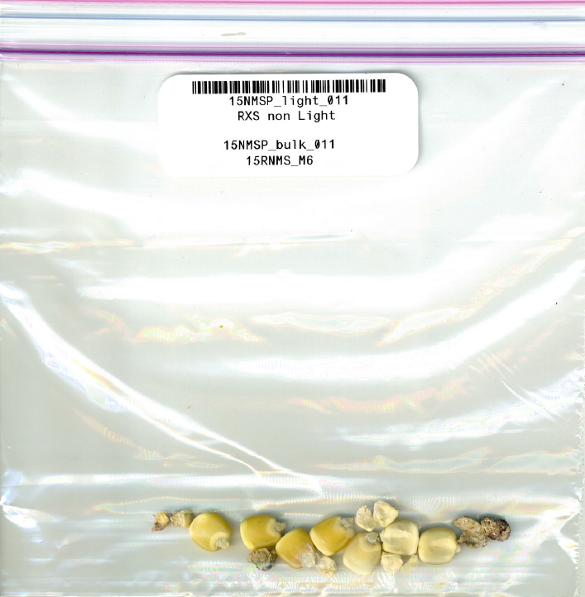
RxS non-inoc
 | Bulk | Heavy | Medium | Light
Weight (g) | 309 | 296 | 9.32 | 3.21
Vol (mL) | 395 | 377 | 14.8 | 5.6
Bulk Density (g/mL) | 0.783 | 0.785 | 0.630 | 0.573
Proportion (%) | 100 | 95.9 | 3.02 | 1.04
AF (ppb) |  | 1.39, 0 | 30.8 | 26.2

Slide 14
RxS inoc
 | Bulk | Heavy | Medium | Light
Weight (g) | 306 | 295 | 9.68 | 1.37
Vol (mL) | 395 | 380 | 15.0 | 2.5
Bulk Density (g/mL) | 0.775 | 0.776 | 0.645 | 0.548
Proportion (%) | 100 | 96.4 | 3.16 | 0.45
AF (ppb) |  | 2.73, 2.55 | 0.415 | 2.60

Slide 15
SxS non-inoc
 | Bulk | Heavy | Medium | Light
Weight (g) | 299 | 281 | 16.1 | 1.52
Vol (mL) | 390 | 360 | 24.4 | 4.0
Bulk Density (g/mL) | 0.766 | 0.781 | 0.660 | 0.380
Proportion (%) | 100 | 94.1 | 5.39 | 0.51
AF (ppb) |  | 0.760, 0.888 | 0.888 | 7.66

Slide 16
SxS inoc
 | Bulk | Heavy | Medium | Light
Weight (g) | 301 | 288 | 11.1 | 1.70
Vol (mL) | 390 | 370 | 17.5 | 2.5
Bulk Density (g/mL) | 0.772 | 0.778 | 0.634 | 0.680
Proportion (%) | 100 | 95.7 | 3.69 | 0.57
AF (ppb) |  | 0.668, 1.16 | 26.5 | 25.2

